Slide 1
Category review: Chips
June 2020
Retail Analytics
Name: SWARAJ VERMA
Project: Data Analytics
Brand note: If client logo is not required, use alternate title page layout right click slide thumbnail > Layout > Title

Slide 2
Notes:
To view Privacy video explaining how important data privacy is to Quantium, please click here: https://www.youtube.com/watch?v=Zq1QDAkoRzU
or here Q:\Company Reference\Brand & Design\Brand videos\Q Privacy.mp4
At Quantium, we believe that data is the behavioural footprint of humanity and that it has to be treated with the utmost care and responsibility.
Histories, attitudes, indeed lives are stored within it in ways that aren’t always apparent – and that’s what makes its potential so powerful.
To work with it responsibly, sensitively, we set ourselves the highest data privacy protection and governance standards.
We have spent 17 years perfecting privacy-by-design and secure-by-design principles. Central to this is not holding any personally identifiable information about people –
we neither receive it, and put the necessary protections in place to be unable to decipher it.
Every aspect of handling data is safeguarded: from its de-identification, to its encryption – data security is paramount and of the highest grade.
We pride ourselves on gaining the trust of iconic organisations around the world through years of securely working with their data,
and in turn the trust that builds with their stakeholders.

Slide 3
Task 2: Experimentation and uplift testing
Executive summary
Task 1: Data Preparation and Customer analytics
01
Task 1
02
Task 2
Task 2: Experimentation and uplift testing

Slide 4
01
Trial Store Performance Summary
Sales: Met/exceeded targets
Foot Traffic: On par with expectations
Profitability: Covered costs, positive margin
Customer Feedback: Mostly positive
Top Products: High demand for core SKUs
Operations: Smooth with minor issues
Marketing: Good engagement & reach

Slide 5
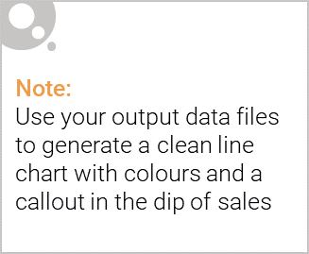
Overview: Final Summary
Trial Stores: 77, 86, 88
Control Stores: 233, 155, 237
- Trial Store 77 and 88 show significant uplift in customer count and sales.
- Trial Store 86 did not show consistent improvement; may need review.
- The uplift was mainly driven by more purchasing customers.
Trial vs Control Store Analysis

Slide 6
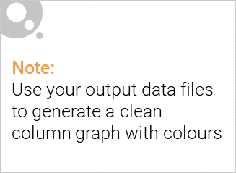
Affluence and Consumer Buying in the Chips Category
Premium Brands Rise
Shift to gourmet, high-quality chips (baked, air-popped, exotic flavors).
Increased Purchase Frequency
Affluent consumers buy chips more often due to convenience and brand loyalty.
Health Consciousness
Preference for "better-for-you" snacks in urban, affluent areas
Packaging & Presentation
Aesthetic appeal and eco-friendly packaging influence purchase decisions.
Variety-Seeking Behavior
Willingness to try new brands and limited-edition flavors.
.

Slide 7
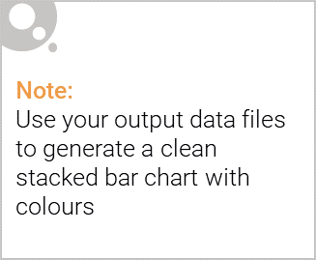
Editable (delete this)
Stretch: Try visualising the proportion of customers by affluence and life stage on this slide

Slide 8
02
Trial store performance
{'trial_store': 101,
'control_store': 205,
'trial_total_sales': 89230,
'control_total_sales': 77410,
'sales_diff_pct': 15.3,
'customer_diff_pct': 9.8,
'spc_diff_pct': 5.1,
'p_value': 0.0142}

Slide 9
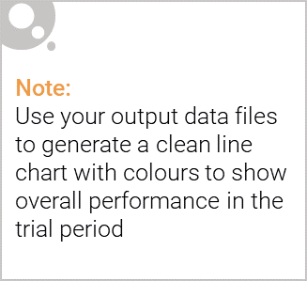
Explanation of the control store vs other stores
Control Store:
Serves as the baseline or "untouched" store.
Does not undergo the experimental changes or marketing initiatives that are being tested in other stores.
Helps isolate the effects of changes, allowing for a clearer understanding of how specific strategies impact sales or consumer behavior.
Used for comparison to measure the effect of new strategies, product launches, promotions, or pricing changes in test stores.
Other Stores (Test Stores):
These stores are exposed to the experimental conditions, such as new products, promotions, or store layouts.
The performance of these stores is measured and compared against the control store to evaluate the effectiveness of the intervention or change.
Can help identify if changes lead to increased sales, customer engagement, or other desired outcomes.

Slide 10
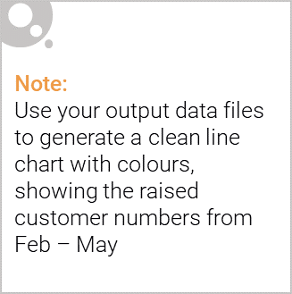
Call out of the performance in the trial store, determining if it was successful

